Slide 1
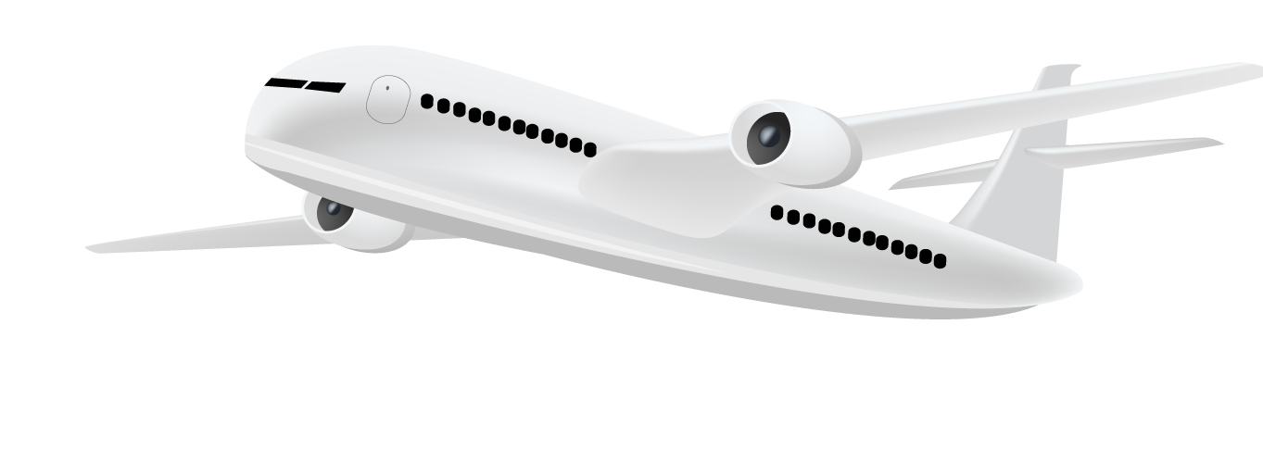
Acorn Airline
Performance Report

Slide 2

Table of contents
01
02
03
04
Dataset Overview
Performance Analysis
Suggestions for improvement
Reasoning

Slide 3
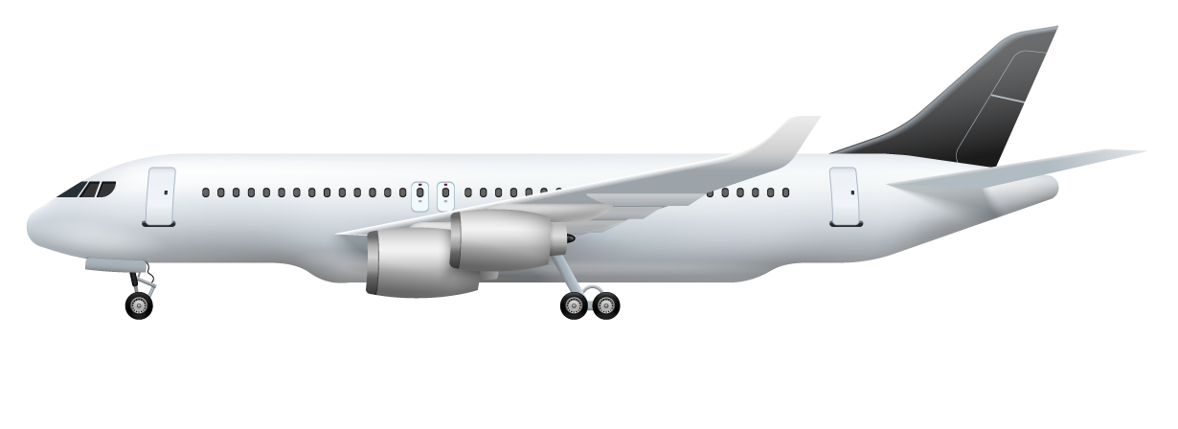
01
Dataset Overview

Slide 4

Dataset Overview
Columns : 25
Rows : 346,580
Timeframe : 01 July - 31 August 2019
Location : USA
Total flights : 346,580 flights
Acorn Airline : 164,490 (47.46%)
Berry Airline : 182,090 (52.54%)

Slide 5

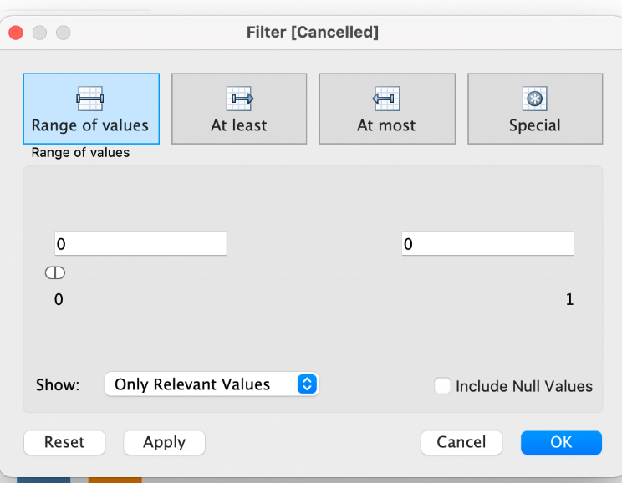
Data Cleaning
Null value
Filtered by Tableau function when necessary
Cancelled flights
Exclude cancelled flights while calculating some proportion
E.g. speed = distance / airtime
Cannot be null
Only keep uncancelled flights (value = 0)
E.g. proportion of delayed flights, proportion of diverted flights

Slide 6
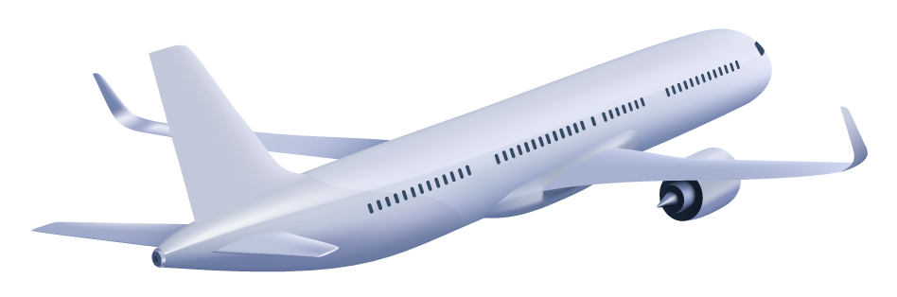

Meet Mr.B
Acorn Airlines or Berry Airlines?
Criteria in choosing airline:
Suitable flights (time and routes)
No/Minimal disruption to his busy schedule

Slide 7
Mr.B’s concerns
Are there large number of choices?
Are there my preferred flight paths?
The shorter the arrival delay, the better!
I don’t want my flight to be cancelled or diverted!

Slide 8

02
Performance Analysis
Comparisons between Acorn Airline and Berry Airline

Slide 9






Analytical Process
Flights
Provided
Delay
Cancelation
Diversion
Detail
Quantity
Route
Taxi-in & Taxi-out
Aircraft efficiency

Slide 10

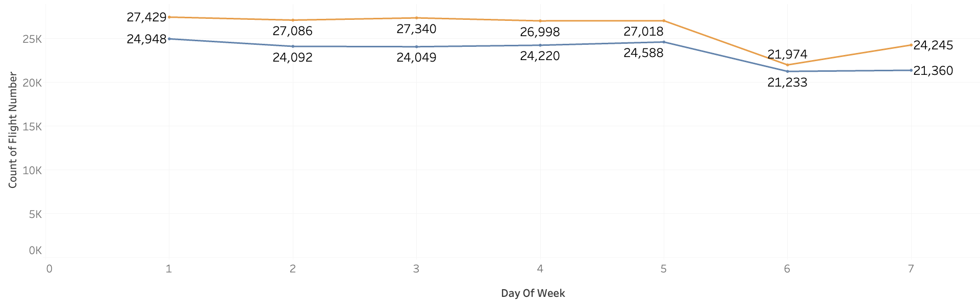
Quantity
Number of Flights Scheduled vs. Day of the Week
Count of Flight Number
Day of Week
General trend: Acorn Airline offers fewer flights everyday (including cancelled flights)
Difference: about 3000 flights/day
BA
AA
Notes:
A general trend that weekdays normally have more flights as compared to weekends

Slide 11
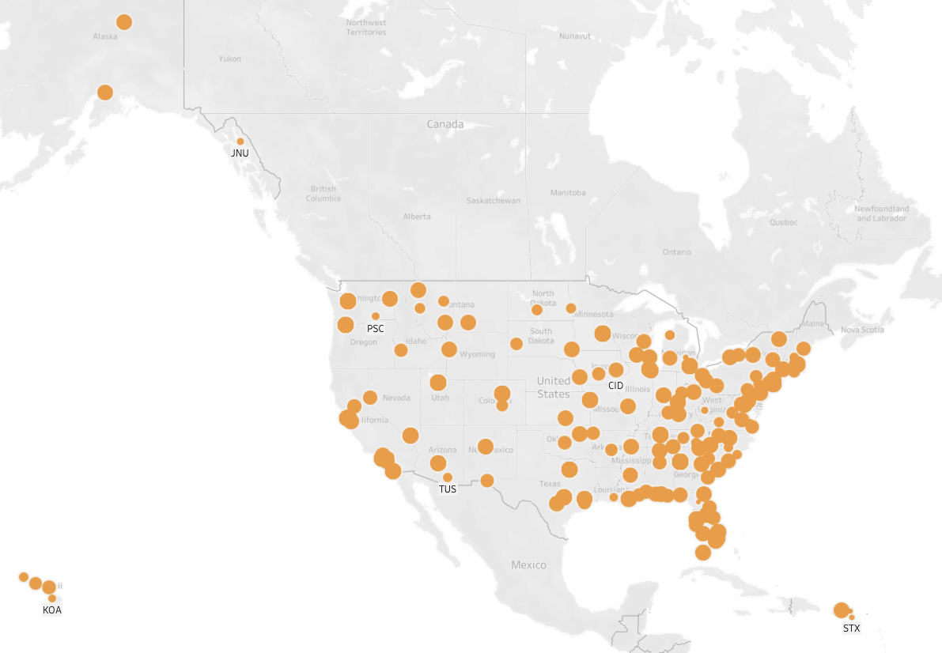
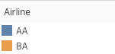
Route
Airports where Berry Airline flights reach

Slide 12
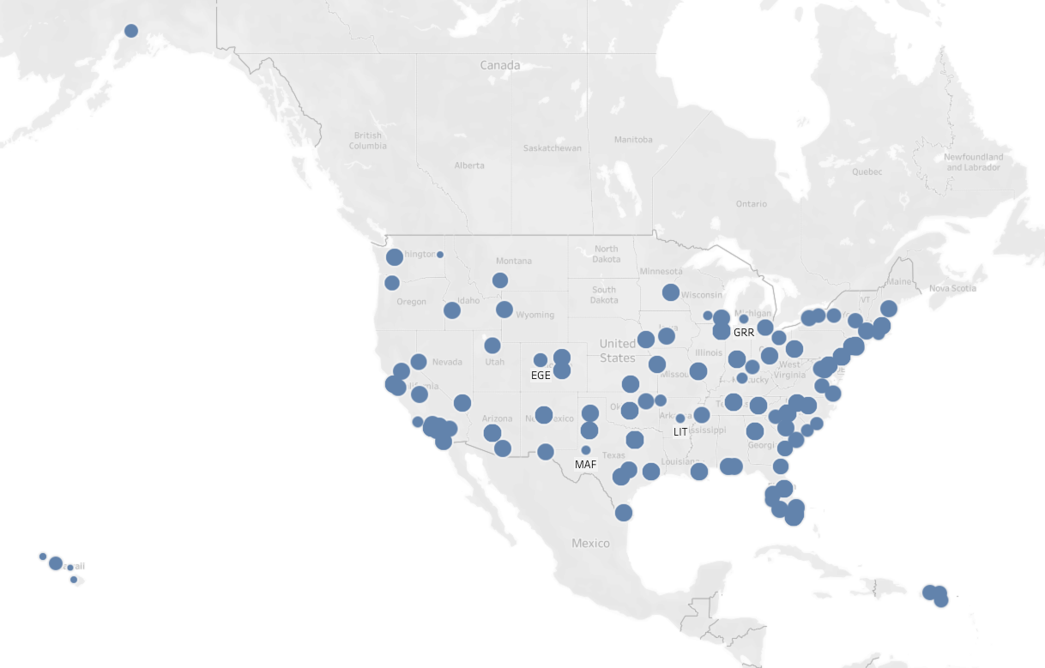
Route
Airports where Acorn Airline flights reach
Acorn Airlines’ flights do not reach certain areas

Slide 13
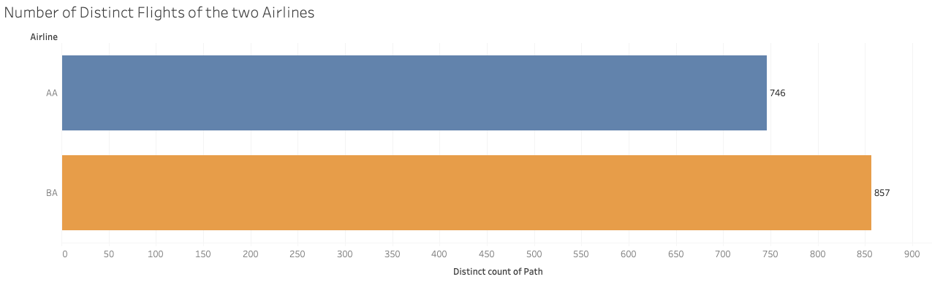
Route
Comparison of Flight Paths
Number of Distinct Flights of the two Airlines
Airline
AA
BB
746
857
Distinct count of Path
857 different flight paths provided by Berry Airlines
746 different flight paths by Acorn Airlines

Slide 14
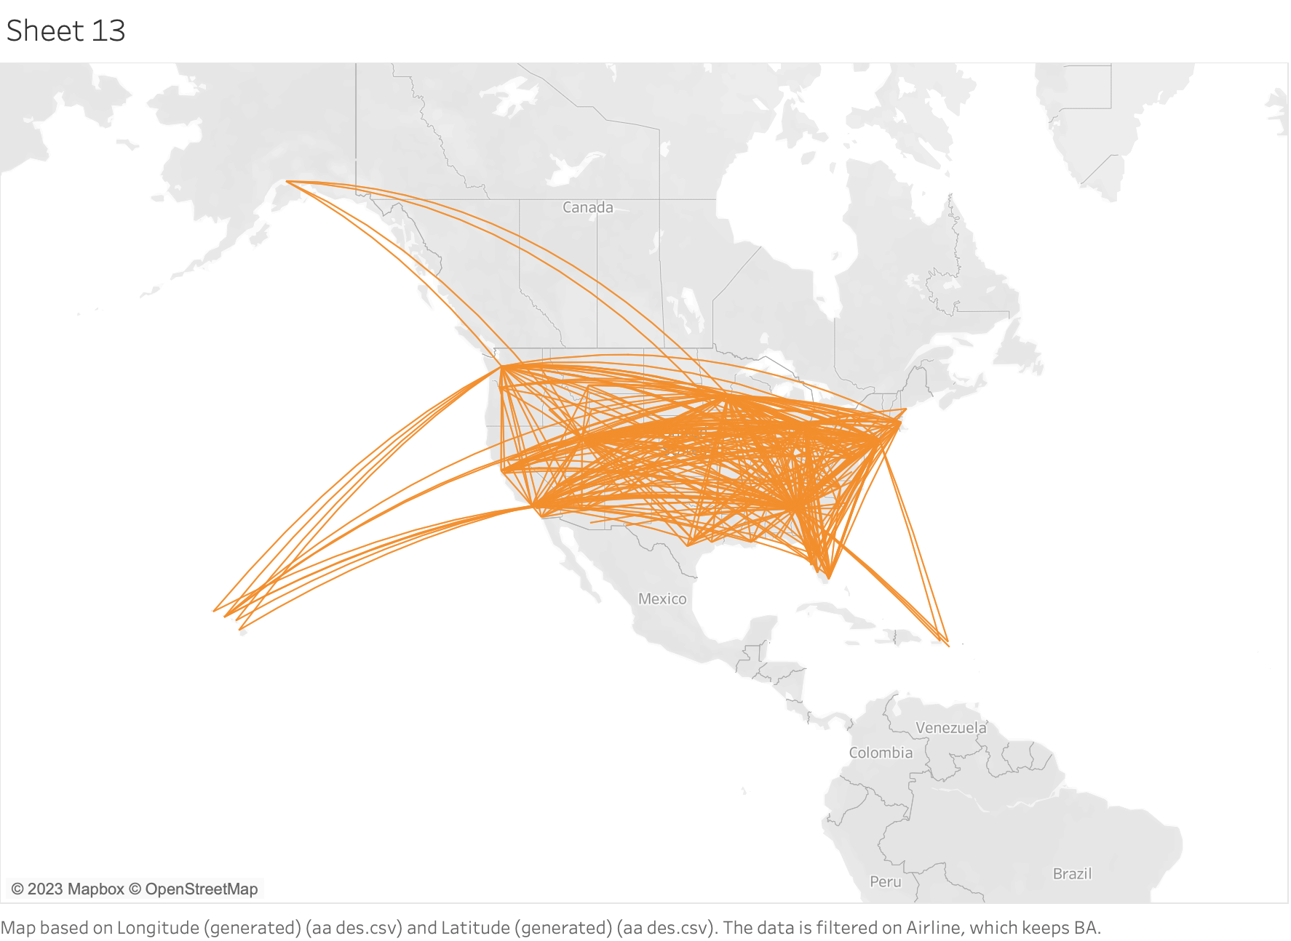
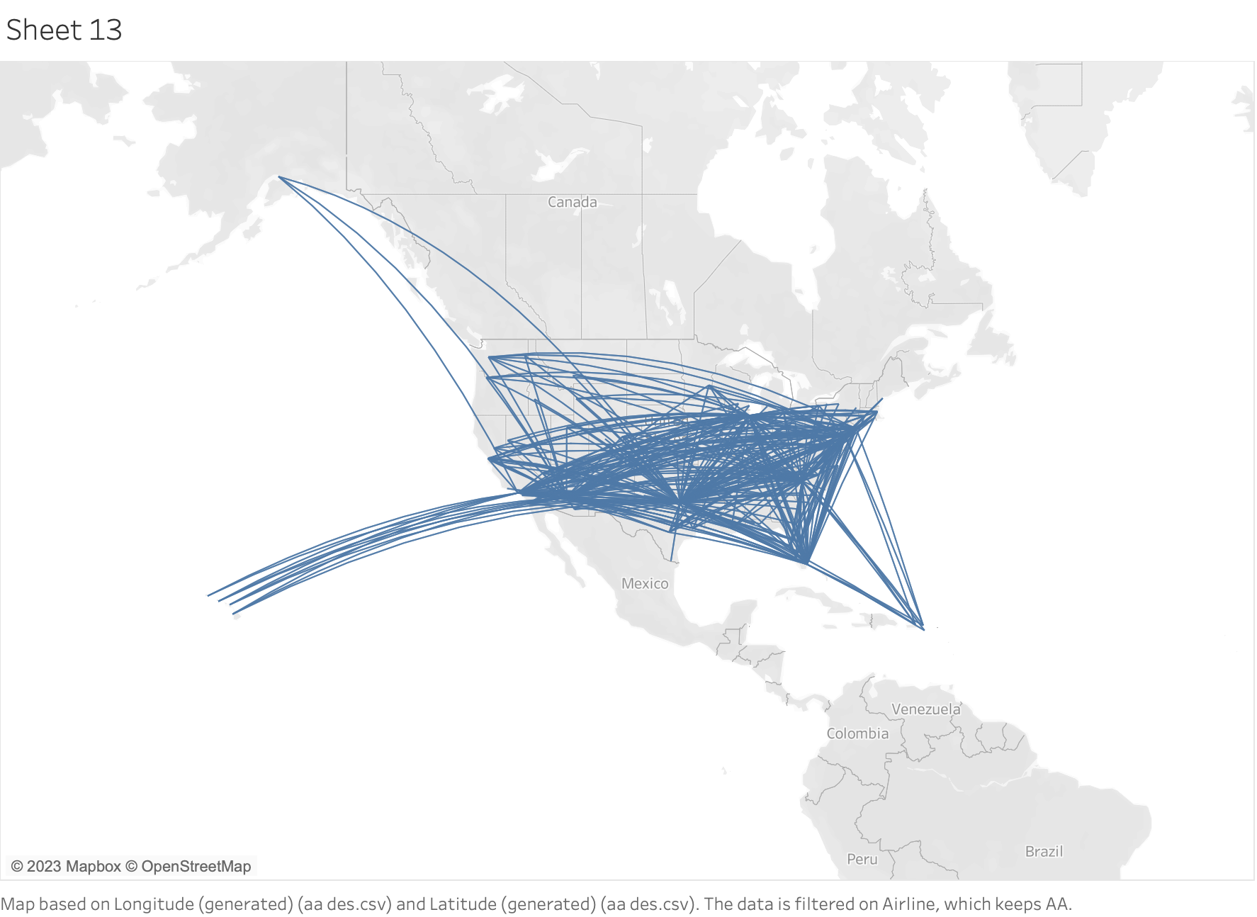
Route
Air routes of Acorn Airlines are mainly focused in South-east regions while Berry Airlines’ routes are more evenly distributed across the country.
Visualized distinct flight paths in map
BA
AA

Slide 15
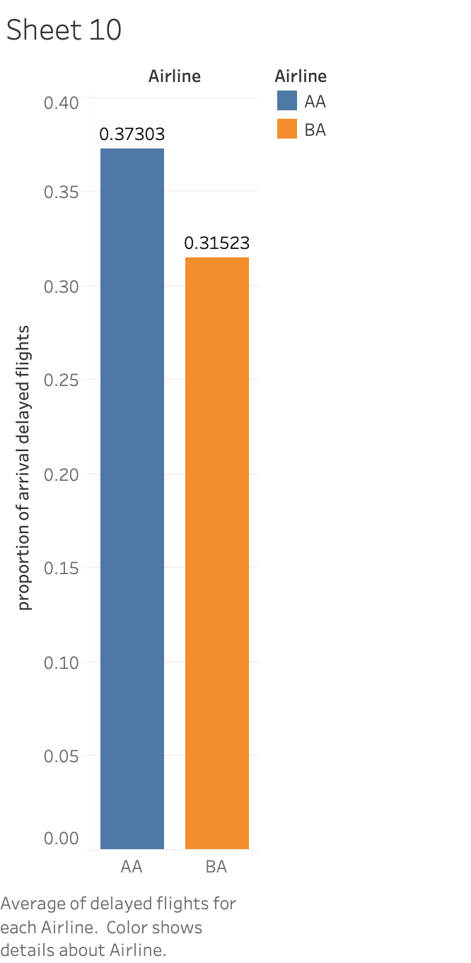
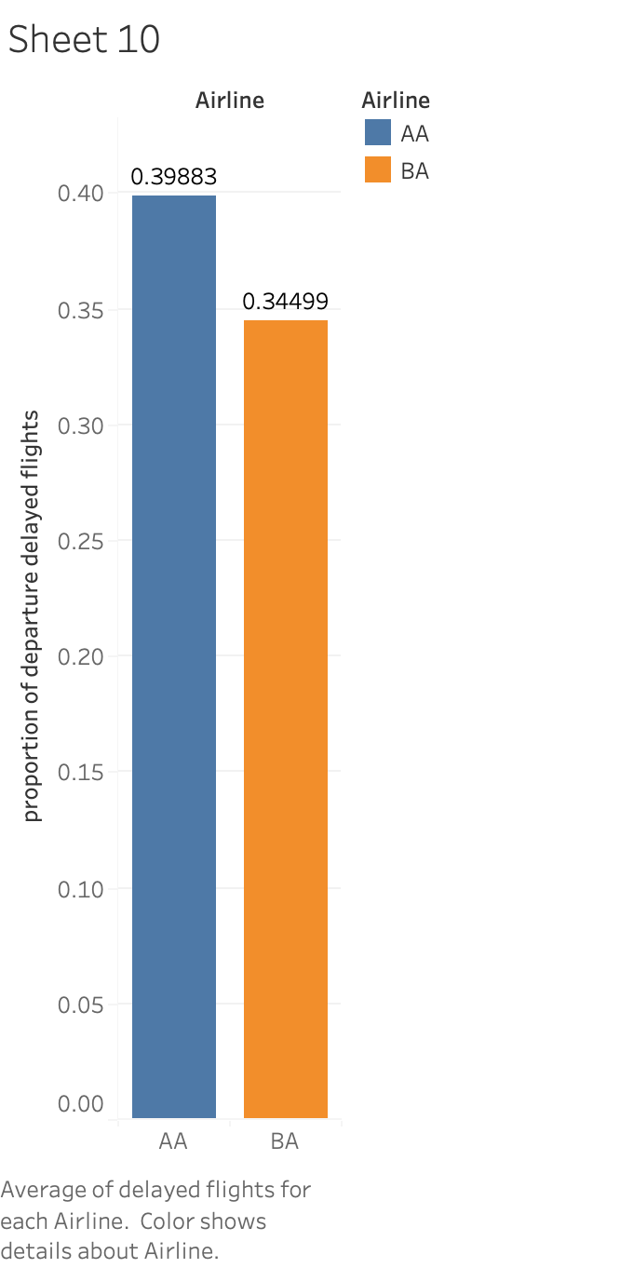
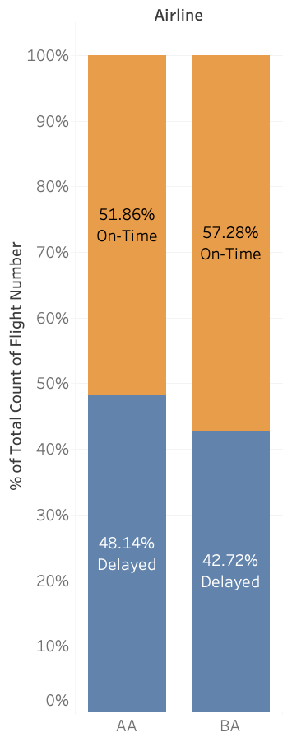
Delays
Proportion of delayed flights
Proportion of arrival delayed flights
Proportion of departure delayed flights
Acorn Airlines has more delayed flights.
In general, the proportion of delayed flights are around 40-50%.
Notes:
Proportion of delayed flights: at least one of departure/arrival delay is positive

Slide 16
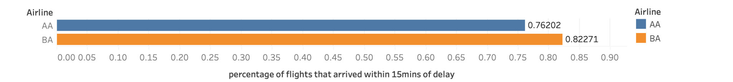
Delays
Percentage of flights arrive within 15 mins after scheduled time
Airline
Percentage of flights that arrive within 15mins of delay
Majority of flights (>75%) arrive with a moderate delay
The percentage of moderately-delayed flights from Acorn Airlines is about 7% less compared to Berry Airlines.

Slide 17
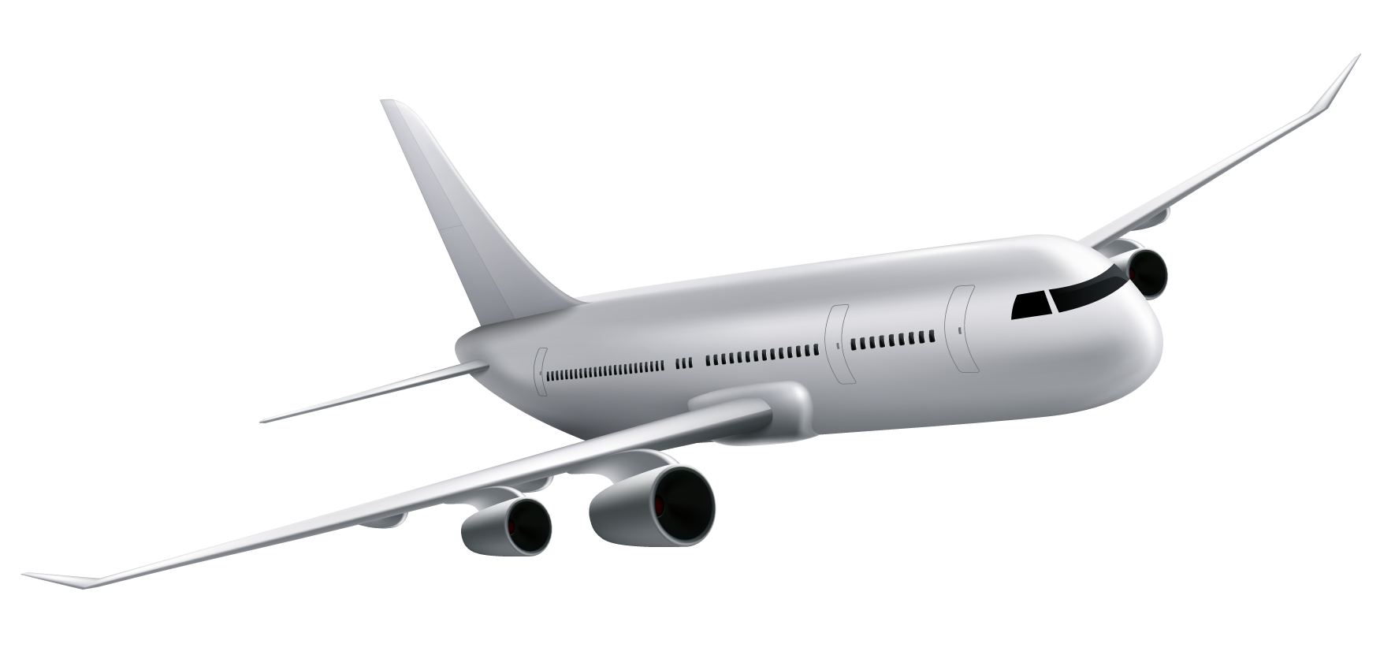
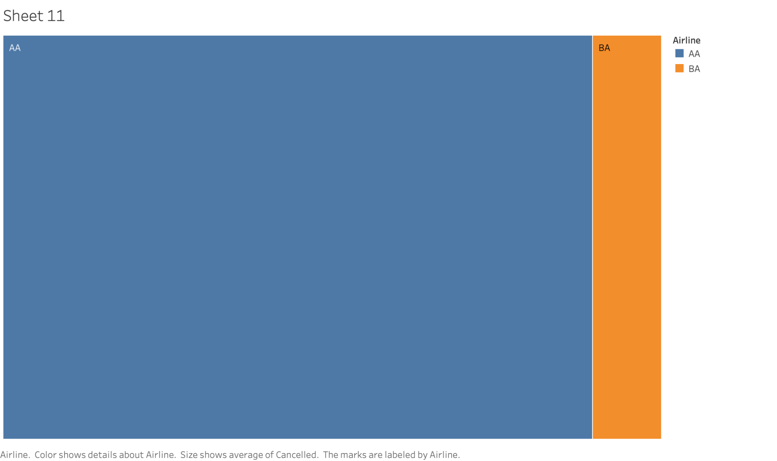
Cancellation
Cancellation rate of two airlines
Cancellation rate:
AA -2.67%
BA - 0.31%
Acorn Airline has a high cancellation rate.
AA
2.67%
BA
0.31%
Notes:
AA’s cancel rate is 9x of BA’s

Slide 18
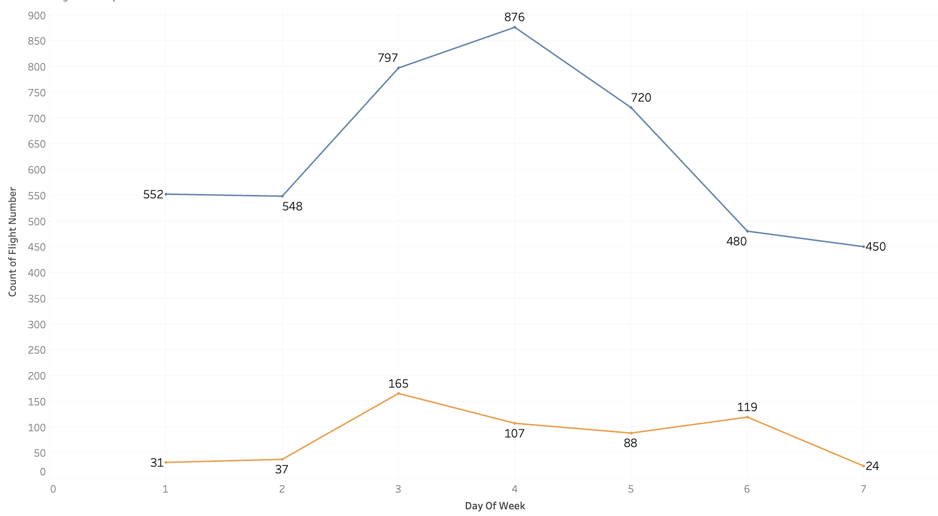
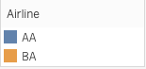
Cancellation
Number of Cancelled Flights vs. Day of Week
Trends:
No. of flights cancelled per day:
Acorn airlines: > 400
Berry airlines: +- 100
During the midweek, the cancellation rate for Acorn airline flights increase.
Count of Flight Number
Day of Week

Slide 19
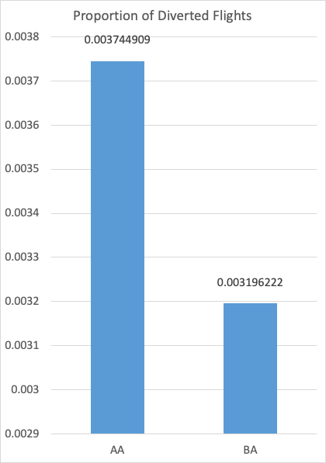
Diversion
Proportion of diverted flights
Diversion rate:
Acorn Airline: 0.385%
Berry Airline: 0.321%
Though the difference seems not significant, the situation can not be estimated positively.
Notes:
Can explain what’s diverted flight first ( it’s a severe situation)

Slide 20
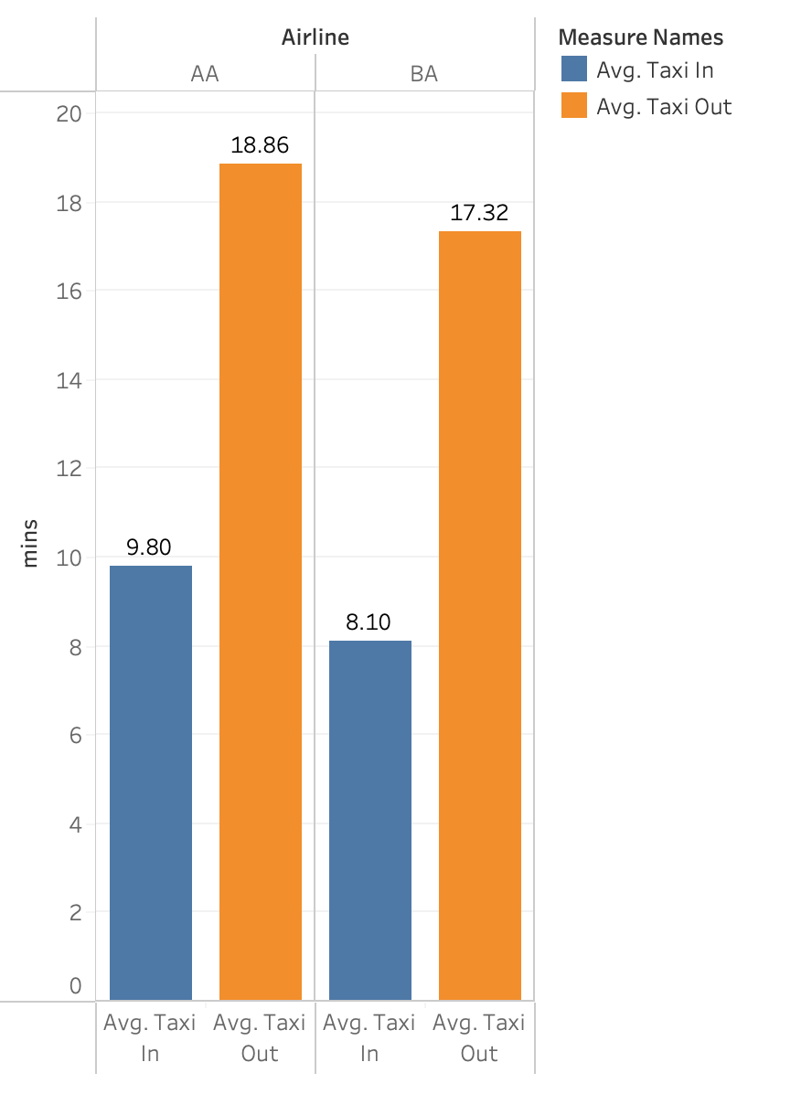
Detail
Average Taxi-in & Taxi-out Time (in mins)
The average taxi-in and taxi-out time of AA are slightly higher, with a 1-min difference
The average taxi-out time nearly doubles the average taxi-in time, which shows higher congestion level at the original airport.
Mins
Notes:
Cancelled flights excluded
Can explain taxi-in/taxi-out time first

Slide 21
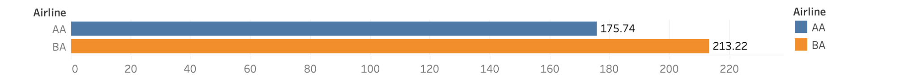
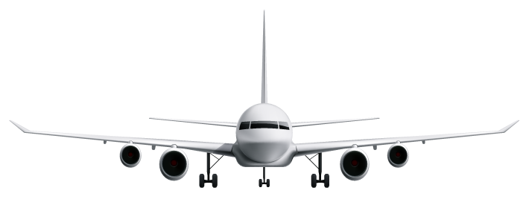
Detail
Aircrafts utilization
Airline
Utilization(num of flight/num of aircraft)
Acorn Airline aircrafts are much less efficient compared to Berry Airline
Difference: ~40 flights/aircraft over 2 months period
Notes:
Efficiency = how many flights each aircraft undertakes

Slide 22
Mr.B’s concern
“More than 30% of the flights would be delayed, I hope this don’t mess up my schedule.”
Why so many flights are being delayed? Let’s find out more!

Slide 23
03
Reasoning
Factors of arrival delay for Acorn Airlines and how they compare against Berry Airlines

Slide 24
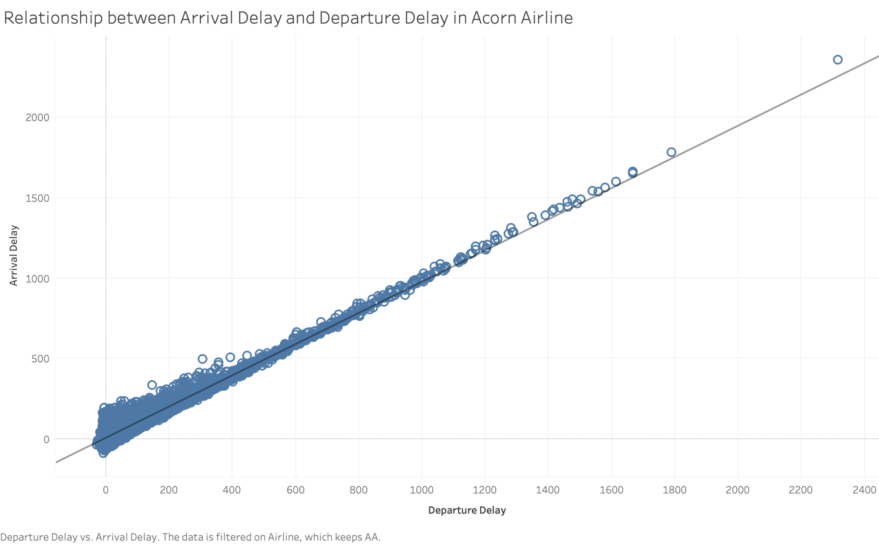
Relationship between Arrival Delay and Departure Delay in Acorn Airline
Arrival Delay vs. Departure Delay
Model:
Arrival delay =
0.967071 * Departure delay + 8.71715
(p-value < 0.0001)
Arrival Delay
Departure Delay

Slide 25
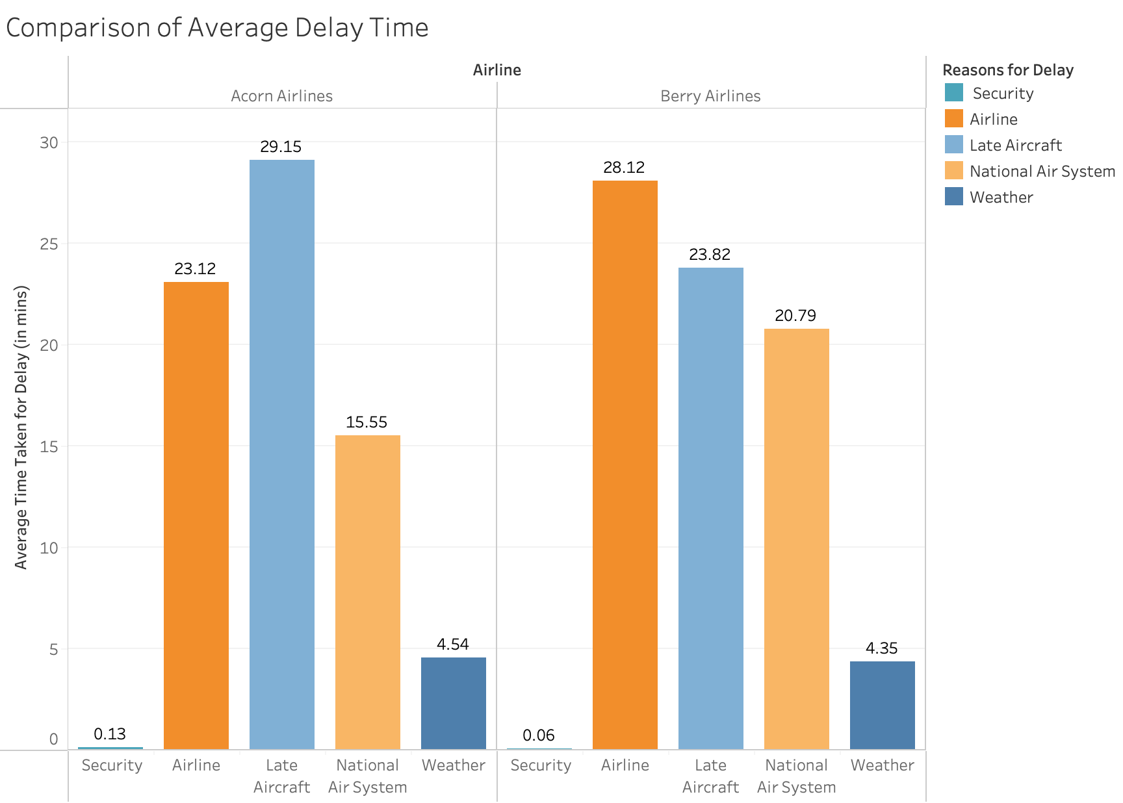
Average delay time for different reasons
Airline
Trends:
Both airlines take similar durations in handling delays
Berry airlines takes longer time in handling delays that is caused by the National Air System.
Average Time Taken for Delay ( in mins)
Reasons for Delay
Notes:
Can explain different kinds of reason for delay first

Slide 26
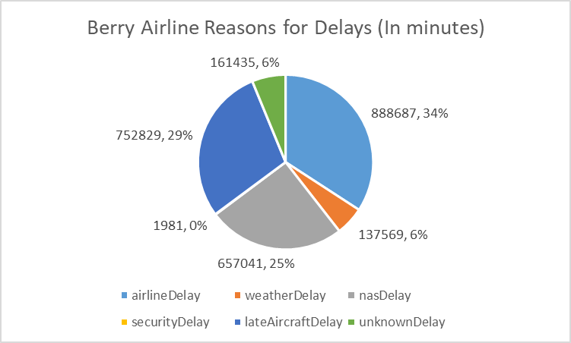
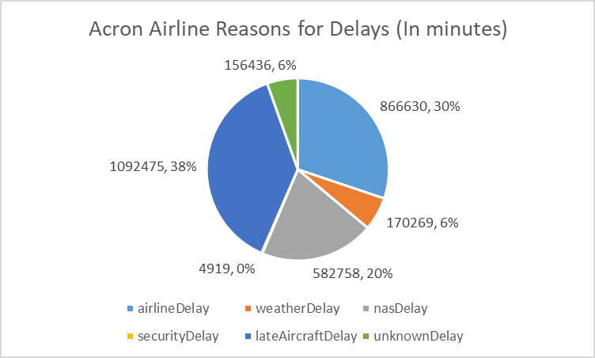
Proportion of different delay reasons
Trends:
Airline Delay & Late Aircraft delay accounts for the most delays for both airlines
Acorn Airline has higher percentage of Late Aircraft Delay
Acorn
Notes:
Explain how the proportion is calculated

Slide 27
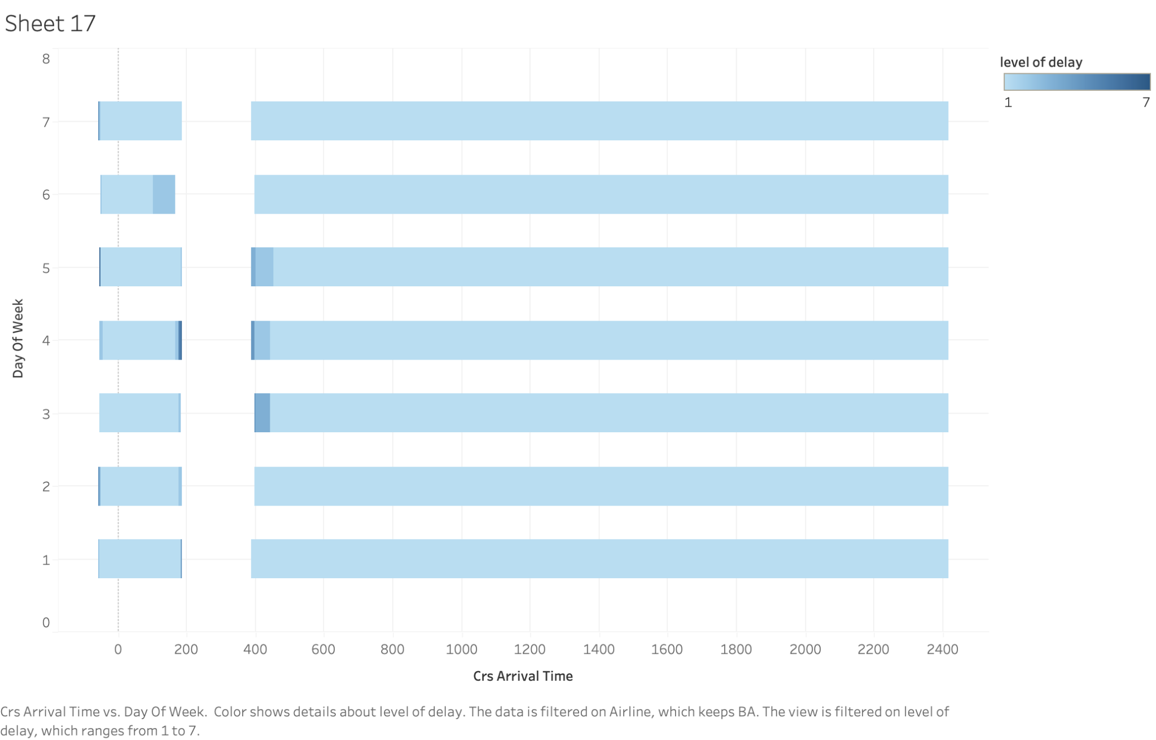
Arrival Delay (in time frame)
Level of Delay
Day of Week
BA
Scheduled Arrival Time
Notes:
Level of delay: IF [Arrival Delay]<=0 THEN 0
ELSEIF [Arrival Delay]<5 THEN 1
ELSEIF [Arrival Delay]<10 THEN 2
ELSEIF [Arrival Delay]<15 THEN 3
ELSEIF [Arrival Delay]<30 THEN 4
ELSEIF [Arrival Delay]<60 THEN 5
ELSEIF [Arrival Delay]<120 THEN 6
ELSE 7 END

Slide 28
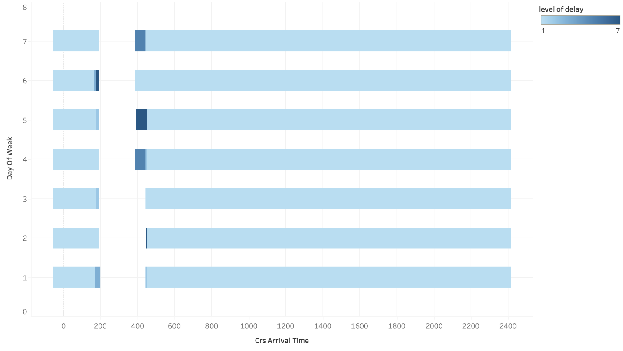
Arrival Delay (in time frame)
Level of Delay
The arrival delay level at following time points is relatively high:
Monday 2am
Thursday 4-5am
Friday 4-5am
Saturday 2am
Sunday 4-5am
All in wee hours
Day of Week
AA
Scheduled Arrival Time

Slide 29
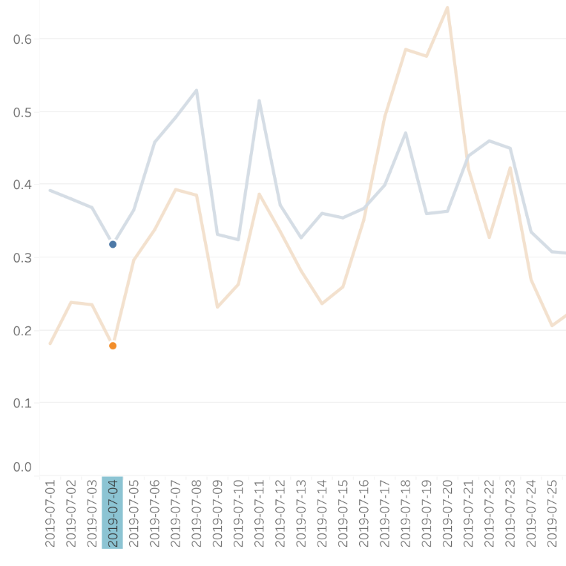
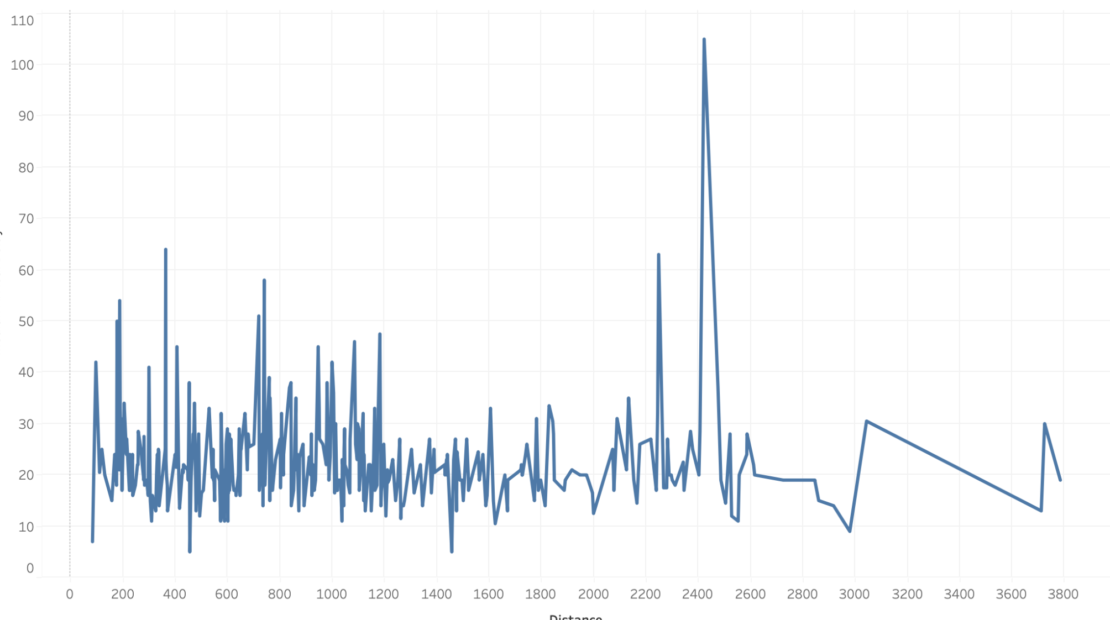
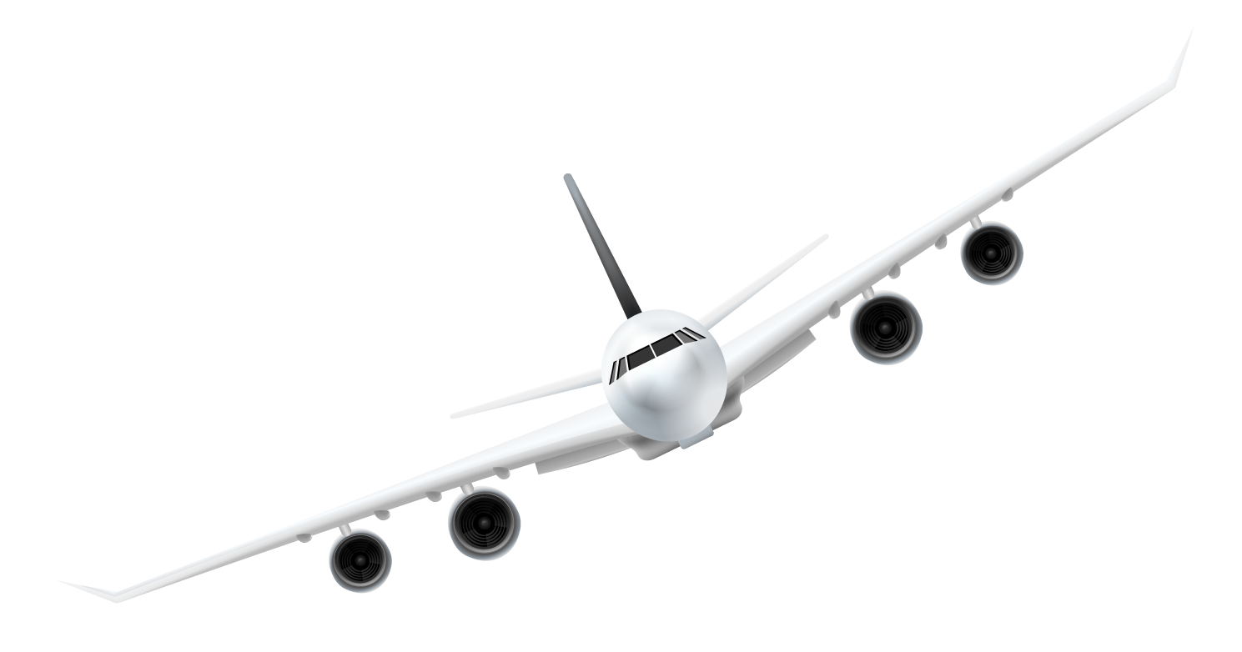
Other attempts
Distance
Holiday
Median of arrival delay
Proportion of Delayed Flights
Independence day
Distance
Flight Date
Lower
No Trend

Slide 30

Factors
1
2
3
Departure Delay
Regular Reasons
Time points
High correlation between departure and arrival delay (intuitively consistent)
Security
Airline
Late Aircraft
National Air System
Weather
Arrival delay is more severe at certain time in certain days

Slide 31
Mr.B’s needs to make a choice…
It seems that Mr.B is going to choose Berry Airlines instead of Acorn Airlines.
How to win Mr.B over?

Slide 32
04
Suggestion for Improvement
What course of actions should Acorn Airlines take to better its performance against Berry Airlines?

Slide 33
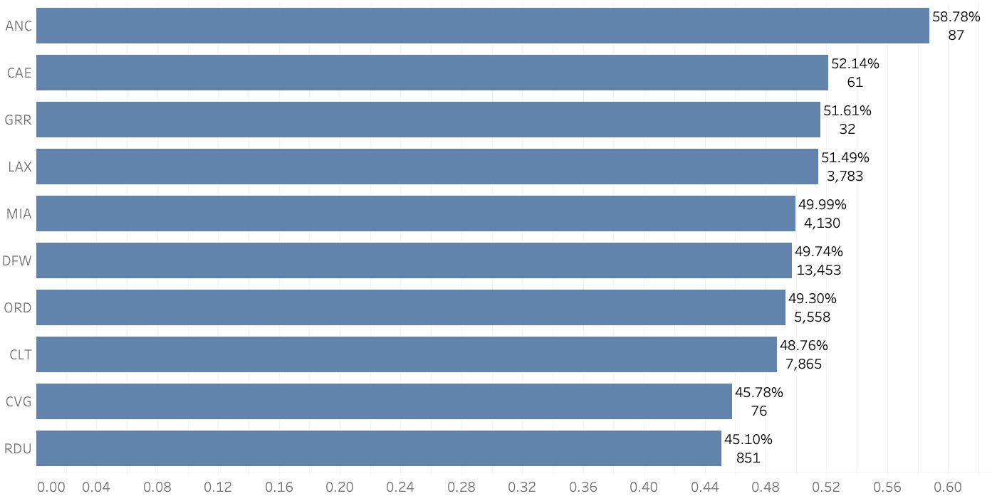
Top 10 Origin Airport where Departure Delay is Most Likely to Happen
Departure Delay > 0
ANC, CAE, GRR, LAX, MIA, DFW, ORD, CLT, CVG
Excluding airports with less than 10 flights
Percentage of Departure Delay Over Total Number of Flights

Slide 34
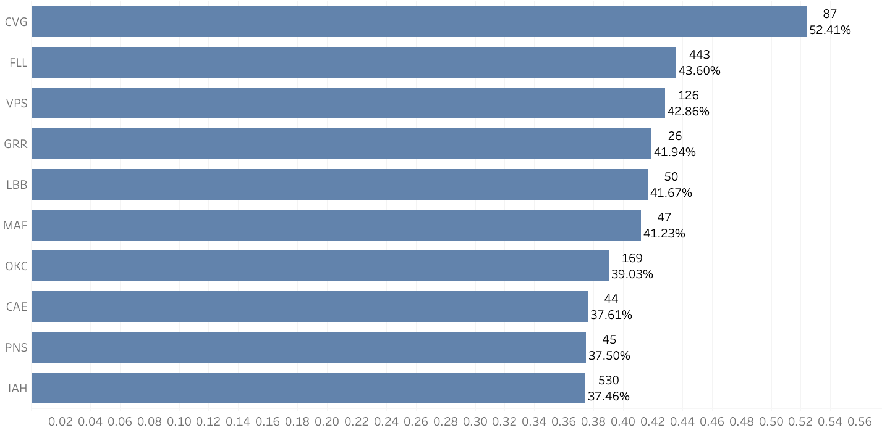
Top 10 Destination Airport where Delay is Most Likely to Happen
Arrival Delay > Departure Delay
CVG, FLL, VPS, GRR, LBB, MAF, OKC, CAE, PNS, IAH
Excluding airports with less than 10 flights
Percentage of Arrival Delay > Departure Delay Overall Total Number of Flights Arrived

Slide 35
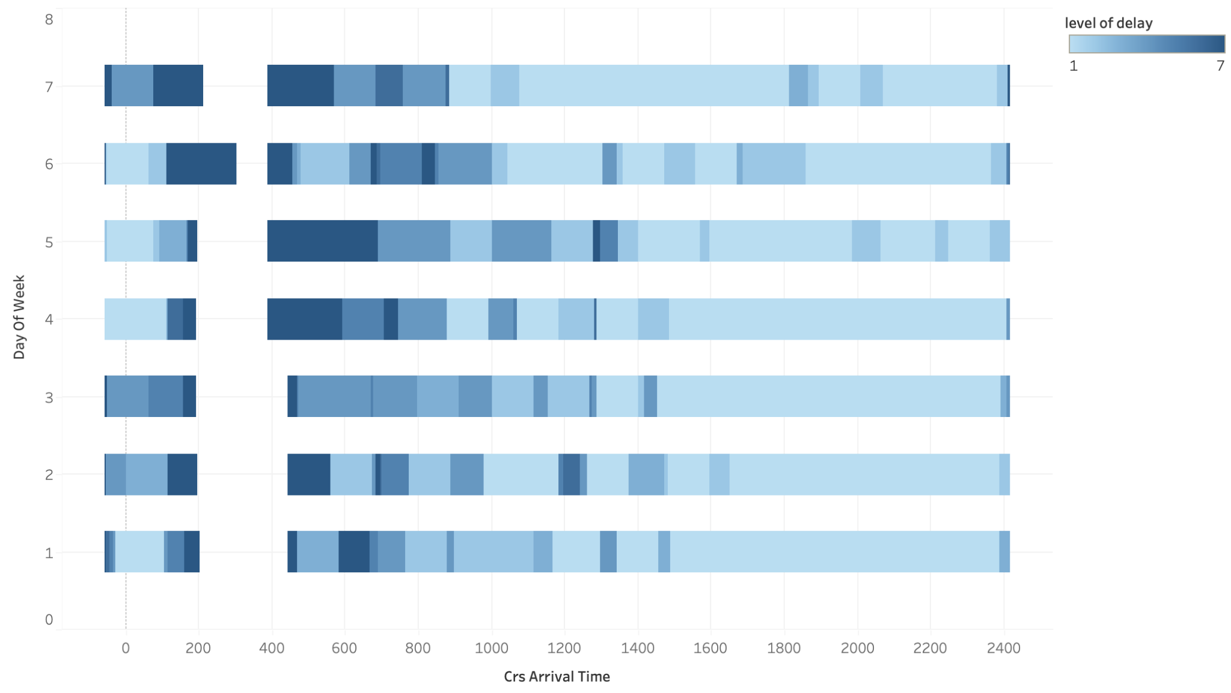
Weather delay (in time frame)
Level of Delay
The weather delay level at midnight - 8am is the highest.
The weather conditions in the afternoon and in the evening are moderate.
Day of week
Scheduled Arrival Time

Slide 36

Suggestions
More flight options for its customers
Cooperate with airports in untouched areas (p11)
Increase the variety of air routes to achieve a balanced service across the country (p12-14)
Could also give more options for same air routes but different timings
Resource Allocation Efficiency
Increase the efficiency of aircraft usage through better flight scheduling (p21)

Slide 37
Suggestions
Improve on Arrival Delay
Schedule for more buffer time
Strengthen supervision over airports on their congestion level (p20)
Pay special attention to Top 10 airports where arrival/departure delay are most likely to happen (p31-32)
Can invest more in tackling late aircraft delay and airline delay first, since they make up more than 60% of arrival delay(p24-25)
Late aircraft - Properly schedule and utilize backup aircrafts (p24-25)
Security - Improve security screening efficiency: investing in better technology, training staff to be more efficient, and streamlining the process to reduce wait times. (p24-25)
Weather - Avoid bad weather by scheduling fewer flights at certain time points (p24-25,p33)
Airline - Invest in better technology and equipment, optimize staffing levels, and streamline procedures to reduce inefficiencies. (p24-25)

Slide 38

Mr.B is more likely to choose Acorn Airlines after such improvement!
🌟
🌟

Slide 39
Thank you !

